Slide 1
New Literacies Teacher Leader Institute Kenya
Professor Hiller A. Spires
Alumni Distinguished Graduate Professor
North Carolina State University
June 2018

Slide 3
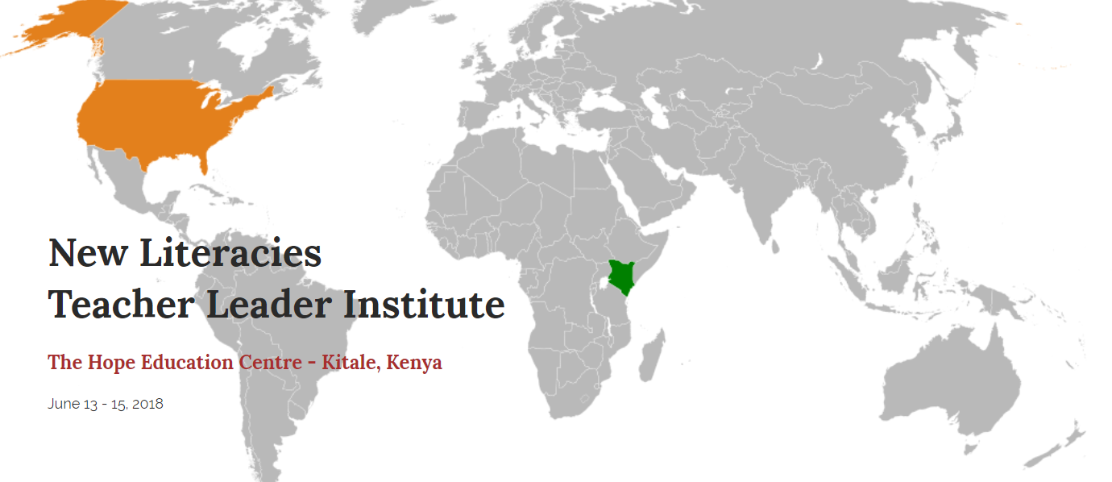
MAP

Slide 4
New Literacies Teacher Leader Institute Overview
Wednesday Agenda:
Introduction to Inquiry-based learning [i.e., Project-based Inquiry (PBI) Global]
Begin your team’s PBI Global
Thursday Agenda:
Learn about literacy strategies that support inquiry
Continue your team’s PBI Global
Friday Agenda:
Finalize your team’s PBI Global
Present your PBI Global at the Design Studio Showcase

Slide 5
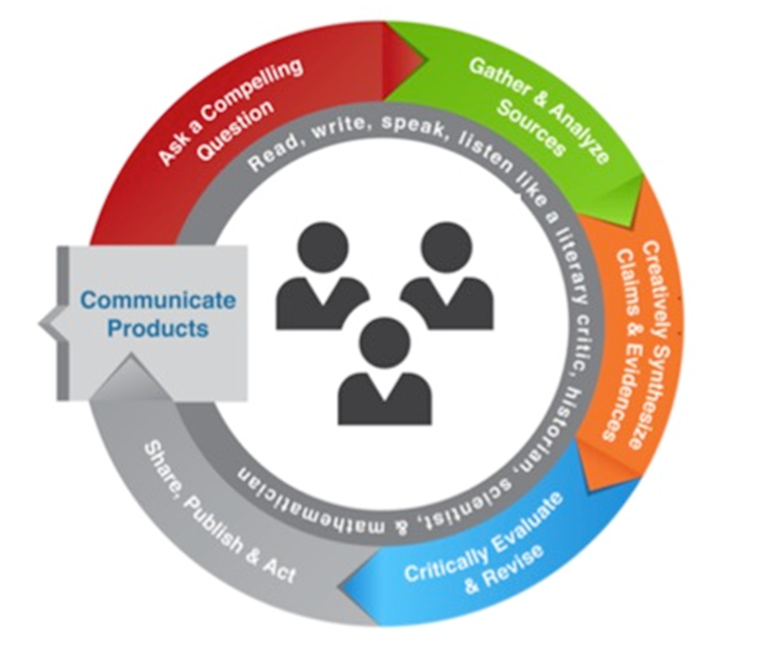
Beginning With The End In Mind
PBI Global Showcase on Friday
60 Minute Gallery Walk
You will share:
Your team’s digital product (i.e., Piktochart) on your computer
Your research (i.e., claims and evidences based on your compelling question)
See Piktochart example
Notes:
Refer to

Slide 6
Looking Up And Out
Professor Hiller A. Spires
Alumni Distinguished Graduate Professor
North Carolina State University

Slide 7
What are Learner-Centered Pedagogies?
Aim at learning needs, interests, aspirations, and cultural backgrounds of students.
Engage students in collaboration, project-based inquiry, technology, and ongoing discussion and dialogue.
Teacher facilitates the learning process rather than being the sole source of information.

Slide 8
Learner-Centered Pedagogies
Dr. Hiller A. Spires
Distinguished Graduate Professor
North Carolina State University
August 23, 2017

Slide 9
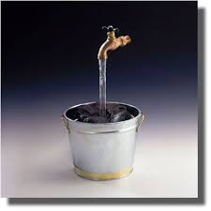
How Do You View Your Role as a Teacher?
A
B
C
D
Notes:
Four Corners activity -

Slide 10
Two Approaches to Teaching

Slide 12
PBI Global Phases
Step 1: Ask a Compelling a Question
Step 2: Gather and Analyze Sources
Step 3: Creatively Synthesize Claims and Evidence
Step 4: Critically Evaluate and Revise
Step 5: Share, Publish, and Act

Slide 13
United Nations
Notes:
17 SDG’s action based

Slide 14
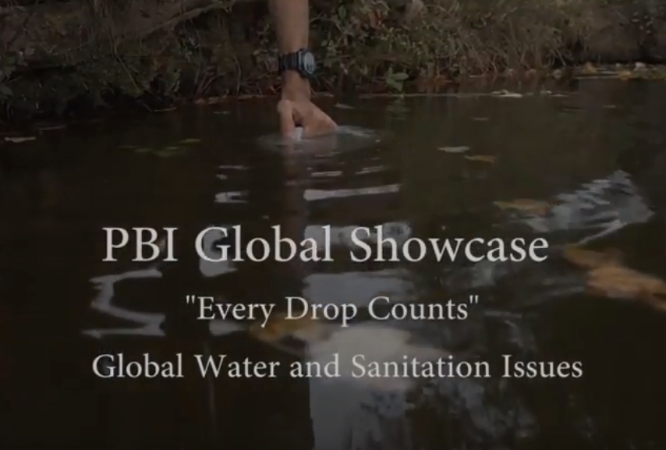
Long Walk to Water
Notes:
https://www.youtube.com/watch?v=yThjYHz3rhM

Slide 15
Turn and Talk
How could you use PBI Global with your students?

Slide 16
Common Read
PBI Global Theme:
Deforestation

Slide 25
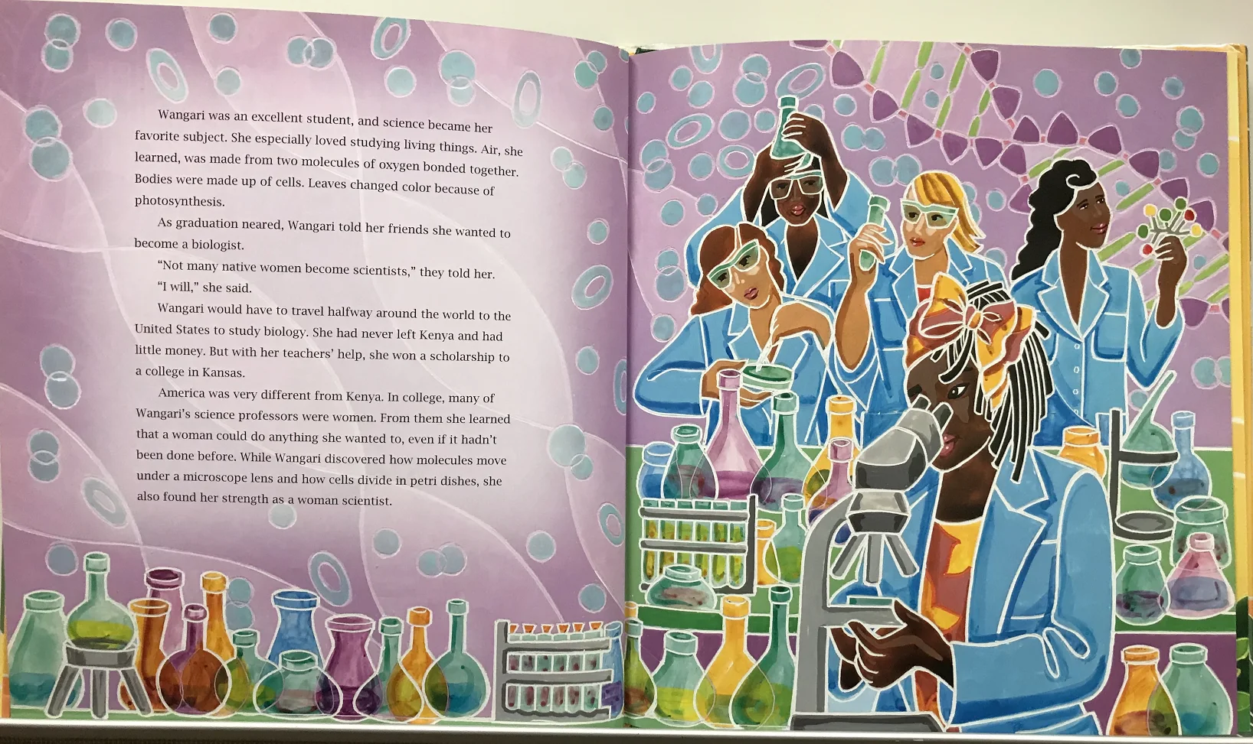

Slide 30
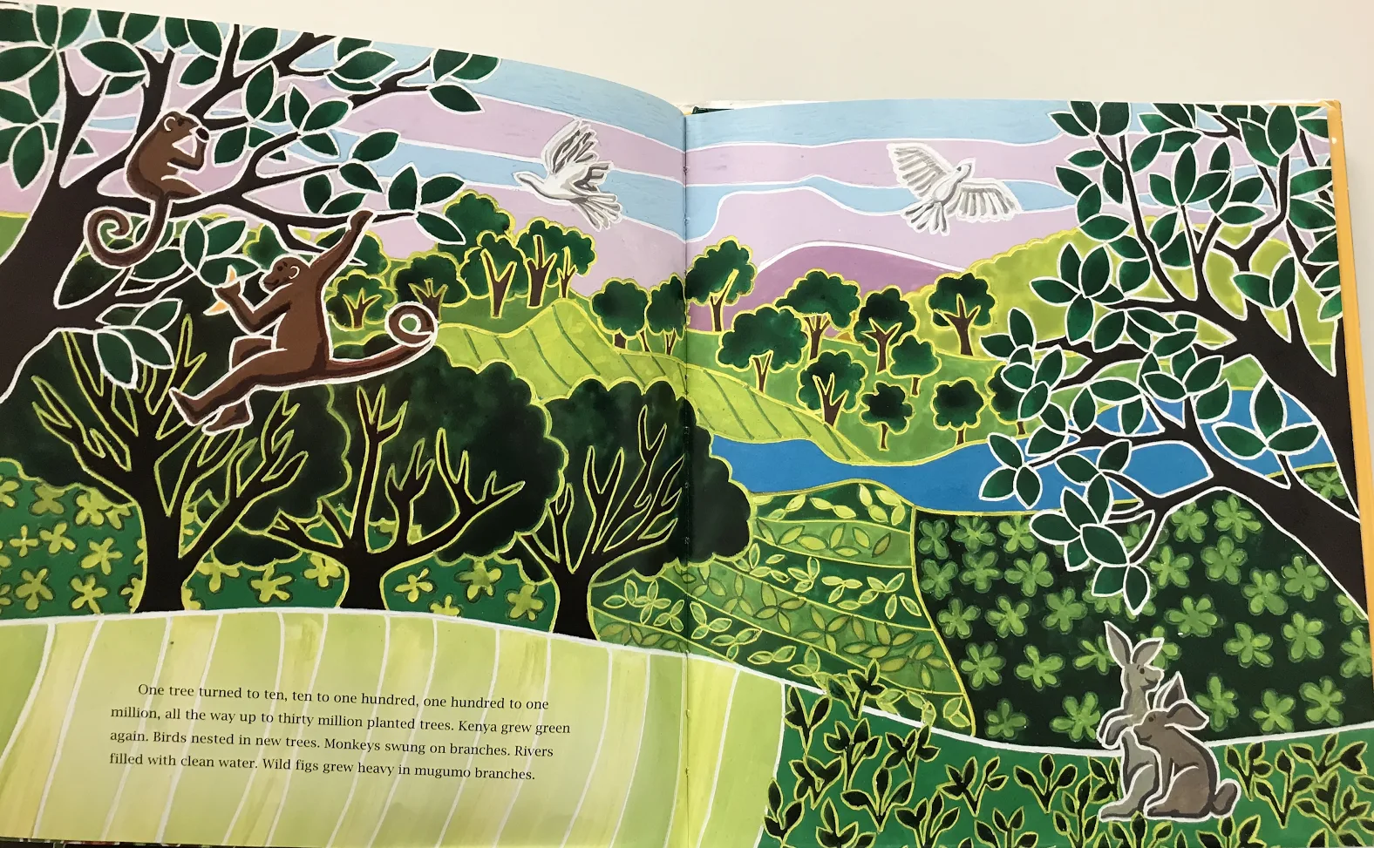

Slide 36
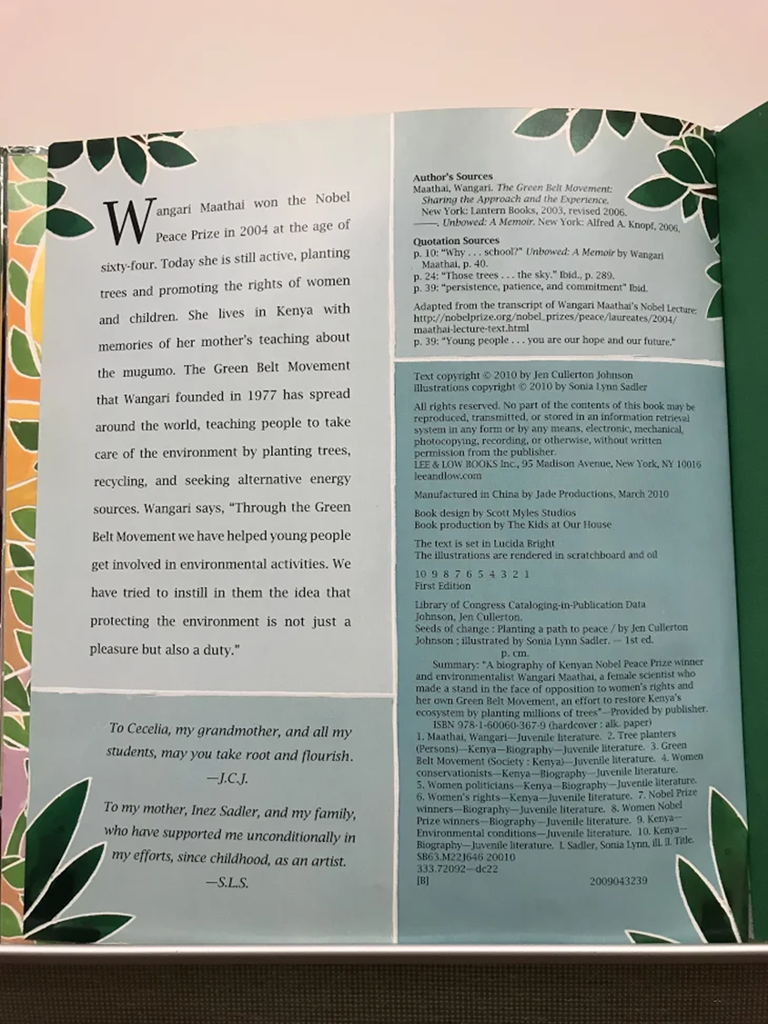

Slide 37
What did you learn about deforestation? How might you use graffiti tables with you students?
Turn and Talk

